Slide 1

The Machine Learning Process
How do I apply multiple filter criteria
to a pandas DataFrame?
Dr. Reza Dibaj

Slide 2
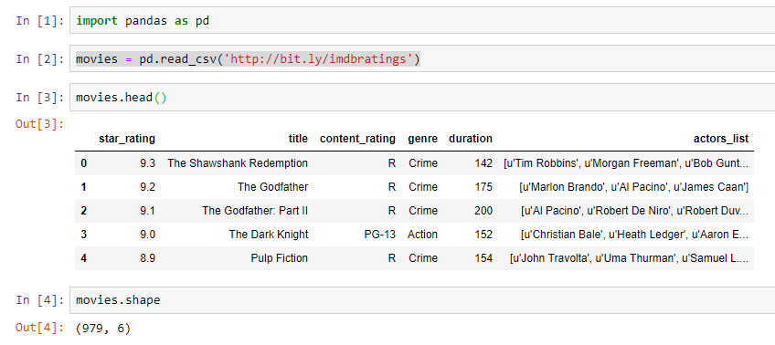
Multiple Filter Criteria in a pandas DF
Let’s pull up an example dataset as follows:
Notes:
import pandas as pd
movies = pd.read_csv('http://bit.ly/imdbratings’)
movies.head()
movies.shape

Slide 3

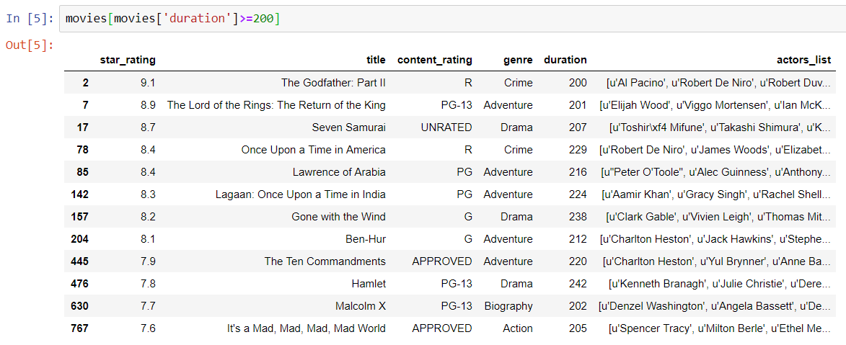
Multiple Filter Criteria in a pandas DF
In order to see the movies that their duration is greater that or equal 200 minutes, we use the following command:
Notes:
movies[movies['duration']>=200]

Slide 4

Multiple Filter Criteria in a pandas DF
What if we want to see the movies that their duration is greater than or equal 200 minutes and their genre is drama?
In this case we have two criteria.

Slide 5
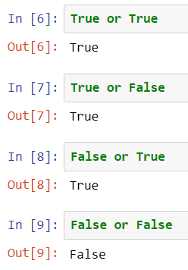
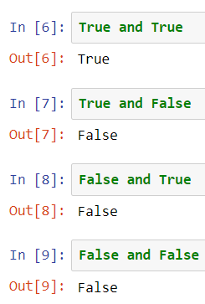
Multiple Filter Criteria in a pandas DF
The followings are a few example for AND and OR:

Slide 6
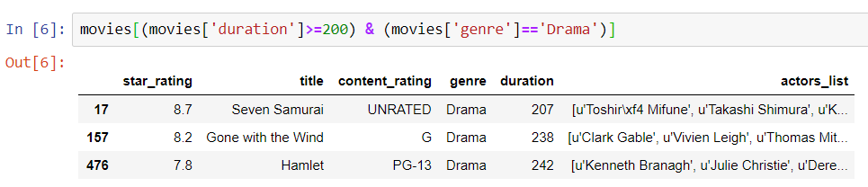
Filtering Rows of a pandas DataFrame
To see the movies that their duration is greater than or equal 200 minutes and their genre is drama we use the following command:
Notes:
(movies['duration']>=200) & (movies['genre']=='Drama’)
movies[(movies['duration']>=200) & (movies['genre']=='Drama’)]

Slide 7
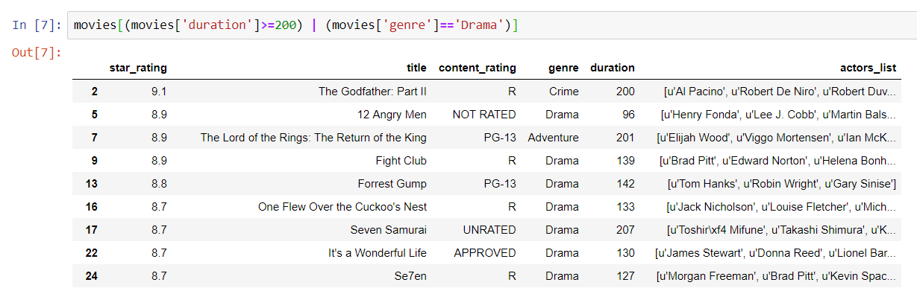

Filtering Rows of a pandas DataFrame
Let’s try the previous example, using OR instead of AND in our logical statement.
And if you want to see the number of rows with these conditions:
Notes:
movies[(movies['duration']>=200) | (movies['genre']=='Drama’)]
movies[(movies['duration']>=200) | (movies['genre']=='Drama')].shape

Slide 8

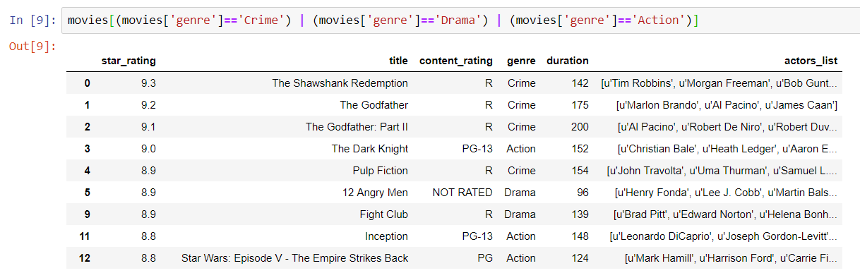
Bonus Tip
What if we have a number of OR conditions with the same Series?
e.g. We want to see the movies that their genre is either crime, or drama, or action.
Notes:
movies[(movies['genre']=='Crime') | (movies['genre']=='Drama') | (movies['genre']=='Action')]

Slide 9
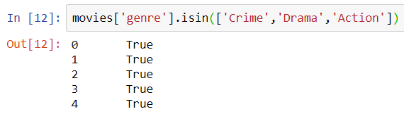
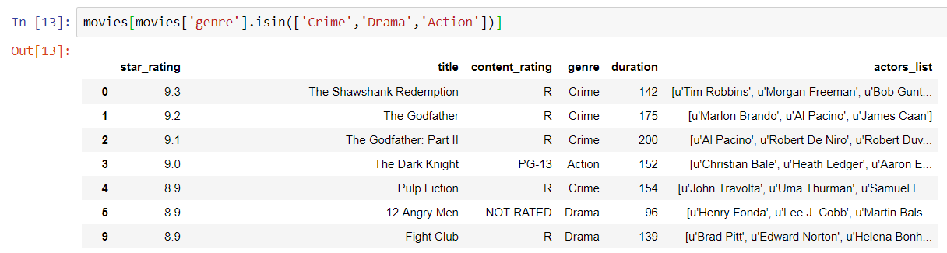
Bonus Tip
And here is another approach for doing the same job more efficiently.
Notes:
movies['genre'].isin(['Crime','Drama','Action’])
movies[movies['genre'].isin(['Crime','Drama','Action’])]

Slide 10

Thank you
Question?
To be
Not to be

